Slide 1
Assessing protein domain homology and trends of multi domain co-occurrence
Erika Hay
Department of Microbiology
MCBL220
Dec 03, 2021

Slide 2
Specific protein of interest: human UBR4
Background
UBR4: E3 ubiquitin-protein ligase UBR4
Relevance to microbiology:
Dengue virus uses UBR4 to degrade an important immune response protein.
Leads to suppression of host immune response.

Slide 3
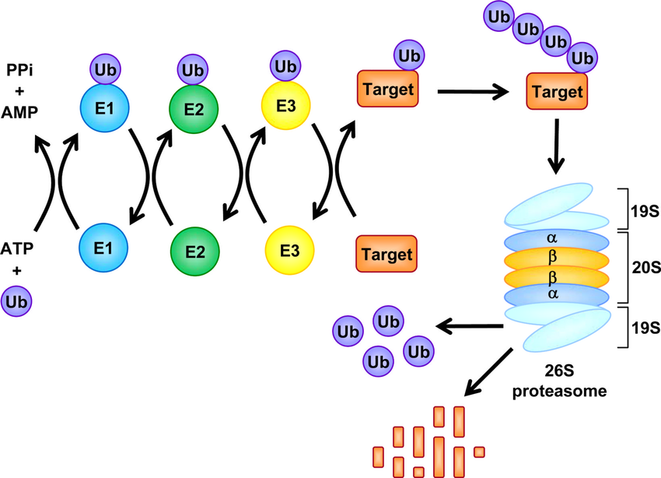
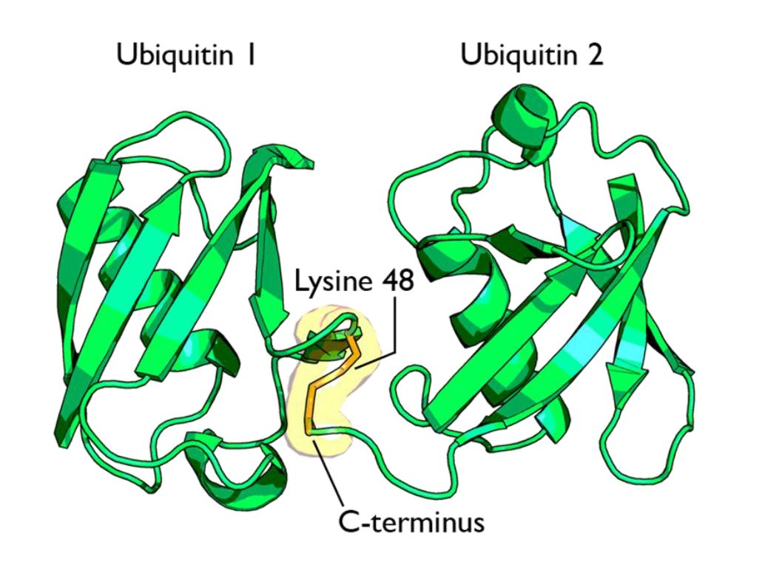
Specific protein of interest: human UBR4
Background
Ubiquitin-Proteasome System:
- Regulates cellular protein abundance; recycles contents.
- Substrate ubiquitination to mark for degradation.
Ubiquitin protein molecule
https://uncommondescent.com/intelligent-design/the-ubiquitin-system-functional-complexity-and-semiosis-joined-together/
Natural Compounds with Proteasome Inhibitory Activity for Cancer Prevention and Treatment - Scientific Figure on ResearchGate. Available from: https://www.researchgate.net/figure/Fig-1-The-Ubiquitin-Proteasome-Pathway_fig1_5319205 [accessed 3 Dec, 2021]

Slide 4
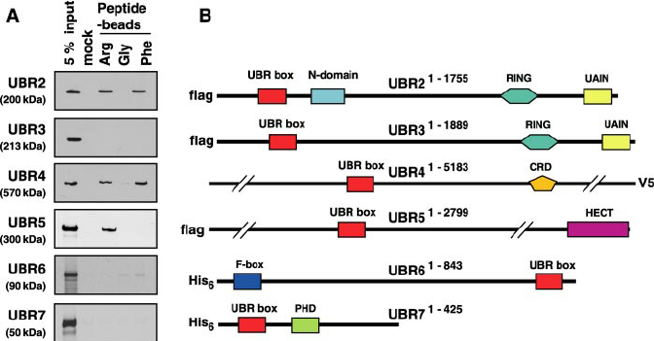
Specific protein of interest: human UBR4
Background
UBR4: E3 ubiquitin-protein ligase UBR4
Family of UBR-box containing proteins
N-end degradation pathway
Giant protein:
~600 kDaltons
~5,183 amino acids
~15,549 nucleotides CDS
The Substrate Recognition Domains of the N-end Rule Pathway - Scientific Figure on ResearchGate. Available from: https://www.researchgate.net/figure/The-binding-properties-of-the-UBR-box-family-members-to-type-1-and-type-2-destabilizing_fig2_23472613 [accessed 3 Dec, 2021]

Slide 5
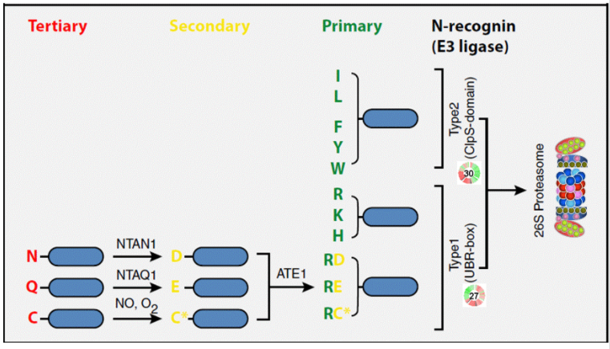
Specific protein of interest: human UBR4
Background
Multi Function protein
N-recognin (UBR box):
Identifies proteins with certain destabilizing N-terminal amino acid residues and contributes to the degradation of such identified protein(s) via the ubiquitin-proteasome system.
N-end Degradation pathway:
Substrate selection
https://mpmp.huji.ac.il/maps/N-end_degr.html

Slide 6
Specific protein of interest: human UBR4
Background
Ubiquitin-Proteasome System: Substrate ubiquitination to mark for degradation
Multi Function protein
E3 ubiquitin ligase in the Ubiquitin-Proteasome System (UPS)
Natural Compounds with Proteasome Inhibitory Activity for Cancer Prevention and Treatment - Scientific Figure on ResearchGate. Available from: https://www.researchgate.net/figure/Fig-1-The-Ubiquitin-Proteasome-Pathway_fig1_5319205 [accessed 3 Dec, 2021]

Slide 7
Specific protein of interest: human UBR4
Background
The Substrate Recognition Domains of the N-end Rule Pathway - Scientific Figure on ResearchGate. Available from: https://www.researchgate.net/figure/The-binding-properties-of-the-UBR-box-family-members-to-type-1-and-type-2-destabilizing_fig2_23472613 [accessed 3 Dec, 2021]
Notes:
UBR1, UBR2, UBR5 all perform both substrate identification and substrate tagging with ubiquitin.
UBR4 is the unusual member since it has no known E3 ligase ubiquitination domain to perform substrate tagging but it is still involved and essential for degradation of various known proteins.

Slide 8
Specific protein of interest: human UBR4
Background
Ubiquitin-Proteasome System: Substrate ubiquitination to mark for degradation
Multi Function protein
E3 ubiquitin ligase:
Caveat, no known ubiquitin ligase catalytic domain
Suspected domain (“E3_UbLigase_R4 domain”) but no research to support that it performs ligation of ubiquitin to substrate
However, evidence supports that it is important for degradation of certain substrates.
Natural Compounds with Proteasome Inhibitory Activity for Cancer Prevention and Treatment - Scientific Figure on ResearchGate. Available from: https://www.researchgate.net/figure/Fig-1-The-Ubiquitin-Proteasome-Pathway_fig1_5319205 [accessed 3 Dec, 2021]

Slide 9
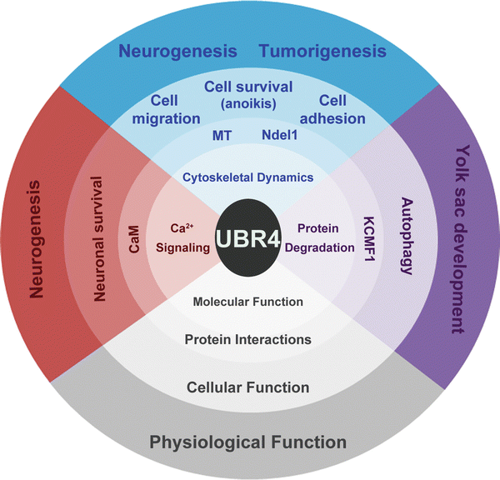
Specific protein of interest: human UBR4
Background
UBR4 is important in many biological processes
Issue:
Most distinguished UBR4 domains are not well characterized.
Uncertain which domains are responsible for UBR4 activities.
Hegazi S., Levine J.D., Cheng HY.M. (2018) UBR4 (Ubiquitin Ligase E3 Component N-Recognin 4). In: Choi S. (eds) Encyclopedia of Signaling Molecules. Springer, Cham. https://doi.org/10.1007/978-3-319-67199-4_101766

Slide 10
Specific protein of interest: human UBR4
Background
Interest:
Role of UBR4 in ubiquitin-proteasome mediated degradation of proteins.
Candidate:
The (putative) E3_UbLigase_R4 domain in human UBR4.
https://www.ncbi.nlm.nih.gov/Structure/cdd/wrpsb.cgi?SEQUENCE=NP_065816.2

Slide 11
Specific protein of interest: human UBR4
Data
Search homologs of the putative human UBR4 E3 ligase domain in other species
Human UBR4 protein sequence, isoform 1 (from Uniprot Q5T4S)
pfam database
Notes:
To investigate the putative E3 ligase of UBR
Other species

Slide 12
Specific protein of interest: human UBR4
Tools & Analysis
Search homologs of the putative human UBR4 E3 ligase domain in other species
HMMER algorithm: phmmer (one sequence against a database) & pfam database
Search pfam database for other domains that co-occur with the UBR4 E3 ligase domain homologs
HMMER algorithm: hmmscan (search protein sequences against collections of profiles) & pfam database
Search the whole proteins matched in 1.
Group matches by the frequency of co-occurring protein domains
Assess top frequency co-occurring protein domains
Determine other possible mode of action for the UBR4 E3 ligase domain
Notes:
To investigate the putative E3 ligase of UBR
Other species
Somewhat relaxed E value
Not a MSA
Local alignment
Helpful to do: Interpro & the UBR4 E3 ligase domain homologs – get GO terms?

Slide 13
Specific protein of interest: human UBR4
Visualization
Most frequent co-occurring protein domains
Display the top 10 hits in a table
Get GO terms to assess functions of all domains
Notes:
To investigate the putative E3 ligase of UBR
Other species
Somewhat relaxed E value
Protein Domain Query | Protein Domain Co-occurrence Match | Evalue

Slide 14
Background on the problem or question you want to address Data that you will use to address this (if this is a data driven project) or an example of type of analyses if more code focused Analysis tools or software you will use -- and/or any new scripts you plan to write A description of these analyses - perhaps graphically you can show the steps of the data analysis. For example see Figures in this DNA methylation analysis pipeline paper (Links to an external site.). How you will summarize or visualize or capture the results to demonstrate what you found (eg will you make a table of data, generate a report, construct data plots and figures?)

